Slide 1
Chapter 12
Design Concepts
Slide Set to accompany
Software Engineering: A Practitioner’s Approach, 8/e
by Roger S. Pressman and Bruce R. Maxim
Slides copyright © 1996, 2001, 2005, 2009, 2014 by Roger S. Pressman
For non-profit educational use only
May be reproduced ONLY for student use at the university level when used in conjunction with Software Engineering: A Practitioner's Approach, 8/e. Any other reproduction or use is prohibited without the express written permission of the author.
All copyright information MUST appear if these slides are posted on a website for student use.
These slides are designed to accompany Software Engineering: A Practitioner’s Approach, 8/e (McGraw-Hill, 2014) Slides copyright 2014 by Roger Pressman.

Slide 2
Design
Mitch Kapor, the creator of Lotus 1-2-3, presented a “software design manifesto” in Dr. Dobbs Journal. He said:
  Good software design should exhibit:
  Firmness: A program should not have any bugs that inhibit its function.
  Commodity: A program should be suitable for the purposes for which it was intended.
  Delight: The experience of using the program should be pleasurable one.
These slides are designed to accompany Software Engineering: A Practitioner’s Approach, 8/e (McGraw-Hill, 2014) Slides copyright 2014 by Roger Pressman.

Slide 3
Software Design
Encompasses the set of principles, concepts, and practices that lead to the development of a high quality system or product
Design principles establish and overriding philosophy that guides the designer as the work is performed
Design concepts must be understood before the mechanics of design practice are applied
Software design practices change continuously as new methods, better analysis, and broader understanding evolve
.
These slides are designed to accompany Software Engineering: A Practitioner’s Approach, 8/e (McGraw-Hill, 2014) Slides copyright 2014 by Roger Pressman.

Slide 4
Software Engineering Design
Data/Class design – transforms analysis classes into implementation classes and data structures
Architectural design – defines relationships among the major software structural elements
Interface design – defines how software elements, hardware elements, and end-users communicate
Component-level design – transforms structural elements into procedural descriptions of software components
These slides are designed to accompany Software Engineering: A Practitioner’s Approach, 8/e (McGraw-Hill, 2014) Slides copyright 2014 by Roger Pressman.

Slide 5

Analysis Model -> Design Model
These slides are designed to accompany Software Engineering: A Practitioner’s Approach, 8/e (McGraw-Hill, 2014) Slides copyright 2014 by Roger Pressman.

Slide 6
Design and Quality
the design must implement all of the explicit requirements contained in the analysis model, and it must accommodate all of the implicit requirements desired by the customer.
the design must be a readable, understandable guide for those who generate code and for those who test and subsequently support the software.
the design should provide a complete picture of the software, addressing the data, functional, and behavioral domains from an implementation perspective.
These slides are designed to accompany Software Engineering: A Practitioner’s Approach, 8/e (McGraw-Hill, 2014) Slides copyright 2014 by Roger Pressman.

Slide 7
Design Principles
The design process should not suffer from ‘tunnel vision.’
The design should be traceable to the analysis model.
The design should not reinvent the wheel.
The design should “minimize the intellectual distance” [DAV95] between the software and the problem as it exists in the real world.
The design should exhibit uniformity and integration.
The design should be structured to accommodate change.
The design should be structured to degrade gently, even when aberrant data, events, or operating conditions are encountered.
Design is not coding, coding is not design.
The design should be assessed for quality as it is being created, not after the fact.
The design should be reviewed to minimize conceptual (semantic) errors.
From Davis [DAV95]
These slides are designed to accompany Software Engineering: A Practitioner’s Approach, 8/e (McGraw-Hill, 2014) Slides copyright 2014 by Roger Pressman.

Slide 8
Fundamental Concepts
Abstraction—data, procedure, control
Architecture—the overall structure of the software
Patterns—”conveys the essence” of a proven design solution
Separation of concerns—any complex problem can be more easily handled if it is subdivided into pieces
Modularity—compartmentalization of data and function
Hiding—controlled interfaces
Functional independence—single-minded function and low coupling
Refinement—elaboration of detail for all abstractions
Refactoring—a reorganization technique that simplifies the design
OO design concepts
Design Classes—provide design detail that will enable analysis classes to be implemented
These slides are designed to accompany Software Engineering: A Practitioner’s Approach, 8/e (McGraw-Hill, 2014) Slides copyright 2014 by Roger Pressman.

Slide 9
Data Abstraction
door
manufacturer
model number
type
swing direction
inserts
lights
type
number
weight
opening mechanism
implemented as a data structure
These slides are designed to accompany Software Engineering: A Practitioner’s Approach, 8/e (McGraw-Hill, 2014) Slides copyright 2014 by Roger Pressman.

Slide 10
Procedural Abstraction
enter
details of enter
algorithm
implemented with a "knowledge" of the
object that is associated with enter
These slides are designed to accompany Software Engineering: A Practitioner’s Approach, 8/e (McGraw-Hill, 2014) Slides copyright 2014 by Roger Pressman.

Slide 11
Architecture
“The overall structure of the software and the ways in which that structure provides conceptual integrity for a system.” [SHA95a]
Structural properties. This aspect of the architectural design representation defines the components of a system (e.g., modules, objects, filters) and the manner in which those components are packaged and interact with one another. For example, objects are packaged to encapsulate both data and the processing that manipulates the data and interact via the invocation of methods
Extra-functional properties. The architectural design description should address how the design architecture achieves requirements for performance, capacity, reliability, security, adaptability, and other system characteristics.
Families of related systems. The architectural design should draw upon repeatable patterns that are commonly encountered in the design of families of similar systems. In essence, the design should have the ability to reuse architectural building blocks.
These slides are designed to accompany Software Engineering: A Practitioner’s Approach, 8/e (McGraw-Hill, 2014) Slides copyright 2014 by Roger Pressman.

Slide 12
Patterns
Design Pattern Template
Pattern name—describes the essence of the pattern in a short but expressive name
Intent—describes the pattern and what it does
Also-known-as—lists any synonyms for the pattern
Motivation—provides an example of the problem
Applicability—notes specific design situations in which the pattern is applicable
Structure—describes the classes that are required to implement the pattern
Participants—describes the responsibilities of the classes that are required to implement the pattern
Collaborations—describes how the participants collaborate to carry out their responsibilities
Consequences—describes the “design forces” that affect the pattern and the potential trade-offs that must be considered when the pattern is implemented
Related patterns—cross-references related design patterns
These slides are designed to accompany Software Engineering: A Practitioner’s Approach, 8/e (McGraw-Hill, 2014) Slides copyright 2014 by Roger Pressman.

Slide 13
Separation of Concerns
Any complex problem can be more easily handled if it is subdivided into pieces that can each be solved and/or optimized independently
A concern is a feature or behavior that is specified as part of the requirements model for the software
By separating concerns into smaller, and therefore more manageable pieces, a problem takes less effort and time to solve.
These slides are designed to accompany Software Engineering: A Practitioner’s Approach, 8/e (McGraw-Hill, 2014) Slides copyright 2014 by Roger Pressman.

Slide 14
Modularity
"modularity is the single attribute of software that allows a program to be intellectually manageable" [Mye78].
Monolithic software (i.e., a large program composed of a single module) cannot be easily grasped by a software engineer.
  The number of control paths, span of reference, number of variables, and overall complexity would make understanding close to impossible.
In almost all instances, you should break the design into many modules, hoping to make understanding easier and as a consequence, reduce the cost required to build the software.
These slides are designed to accompany Software Engineering: A Practitioner’s Approach, 8/e (McGraw-Hill, 2014) Slides copyright 2014 by Roger Pressman.

Slide 15
Modularity: Trade-offs
What is the "right" number of modules
for a specific software design?
module development cost
cost of
software
module
integration
cost
optimal number
number of modules
of modules
These slides are designed to accompany Software Engineering: A Practitioner’s Approach, 8/e (McGraw-Hill, 2014) Slides copyright 2014 by Roger Pressman.

Slide 16
Information Hiding
module
• algorithm
controlled
interface
• data structure
• details of external interface
• resource allocation policy
clients
"secret"
a specific design decision
These slides are designed to accompany Software Engineering: A Practitioner’s Approach, 8/e (McGraw-Hill, 2014) Slides copyright 2014 by Roger Pressman.

Slide 17
Why Information Hiding?
reduces the likelihood of “side effects”
limits the global impact of local design decisions
emphasizes communication through controlled interfaces
discourages the use of global data
leads to encapsulation—an attribute of high quality design
results in higher quality software
These slides are designed to accompany Software Engineering: A Practitioner’s Approach, 8/e (McGraw-Hill, 2014) Slides copyright 2014 by Roger Pressman.

Slide 18
Stepwise Refinement
open
walk to door;
reach for knob;
open door;
repeat until door opens
turn knob clockwise;
walk through;
if knob doesn't turn, then
close door.
take key out;
find correct key;
insert in lock;
endif
pull/push door
move out of way;
end repeat
These slides are designed to accompany Software Engineering: A Practitioner’s Approach, 8/e (McGraw-Hill, 2014) Slides copyright 2014 by Roger Pressman.

Slide 19
Functional Independence
Functional independence is achieved by developing modules with "single-minded" function and an "aversion" to excessive interaction with other modules.
Cohesion is an indication of the relative functional strength of a module.
  A cohesive module performs a single task, requiring little interaction with other components in other parts of a program. Stated simply, a cohesive module should (ideally) do just one thing.
Coupling is an indication of the relative interdependence among modules.
  Coupling depends on the interface complexity between modules, the point at which entry or reference is made to a module, and what data pass across the interface.
These slides are designed to accompany Software Engineering: A Practitioner’s Approach, 8/e (McGraw-Hill, 2014) Slides copyright 2014 by Roger Pressman.

Slide 20
Refactoring
Fowler [FOW99] defines refactoring in the following manner:
  "Refactoring is the process of changing a software system in such a way that it does not alter the external behavior of the code [design] yet improves its internal structure.”
When software is refactored, the existing design is examined for
  redundancy
  unused design elements
  inefficient or unnecessary algorithms
  poorly constructed or inappropriate data structures
  or any other design failure that can be corrected to yield a better design.
These slides are designed to accompany Software Engineering: A Practitioner’s Approach, 8/e (McGraw-Hill, 2014) Slides copyright 2014 by Roger Pressman.

Slide 21
OO Design Concepts
Design classes
  Entity classes
  Boundary classes
  Controller classes
Inheritance—all responsibilities of a superclass is immediately inherited by all subclasses
Messages—stimulate some behavior to occur in the receiving object
Polymorphism—a characteristic that greatly reduces the effort required to extend the design
These slides are designed to accompany Software Engineering: A Practitioner’s Approach, 8/e (McGraw-Hill, 2014) Slides copyright 2014 by Roger Pressman.

Slide 22
What is a Relationship?
Data objects are connected to one another in different ways.
  A connection is established between person and car because the two objects are related.
    A person owns a car
    A person is insured to drive a car
The relationships owns and insured to drive define the relevant connections between person and car.
Several instances of a relationship can exist
Objects can be related in many different ways
These slides are designed to accompany Software Engineering: A Practitioner’s Approach, 8/e (McGraw-Hill, 2014). Slides copyright 2014 by Roger Pressman.

Slide 23
Chapter 13
Architectural Design
Slide Set to accompany
Software Engineering: A Practitioner’s Approach, 8/e
by Roger S. Pressman and Bruce R. Maxim
Slides copyright © 1996, 2001, 2005, 2009, 2014 by Roger S. Pressman
For non-profit educational use only
May be reproduced ONLY for student use at the university level when used in conjunction with Software Engineering: A Practitioner's Approach, 8/e. Any other reproduction or use is prohibited without the express written permission of the author.
All copyright information MUST appear if these slides are posted on a website for student use.
These slides are designed to accompany Software Engineering: A Practitioner’s Approach, 8/e (McGraw-Hill, 2014). Slides copyright 2014 by Roger Pressman.

Slide 24
Why Architecture?
The architecture is not the operational software. Rather, it is a representation that enables a software engineer to:
(1) analyze the effectiveness of the design in meeting its stated requirements,
(2) consider architectural alternatives at a stage when making design changes is still relatively easy, and
(3) reduce the risks associated with the construction of the software.
These slides are designed to accompany Software Engineering: A Practitioner’s Approach, 8/e (McGraw-Hill, 2014). Slides copyright 2014 by Roger Pressman.

Slide 25
Why is Architecture Important?
Representations of software architecture are an enabler for communication between all parties (stakeholders) interested in the development of a computer-based system.
The architecture highlights early design decisions that will have a profound impact on all software engineering work that follows and, as important, on the ultimate success of the system as an operational entity.
Architecture “constitutes a relatively small, intellectually graspable mode of how the system is structured and how its components work together” [BAS03].
These slides are designed to accompany Software Engineering: A Practitioner’s Approach, 8/e (McGraw-Hill, 2014). Slides copyright 2014 by Roger Pressman.

Slide 26
Architectural Styles
Each style describes a system category that encompasses: (1) a set of components (e.g., a database, computational modules) that perform a function required by a system, (2) a set of connectors that enable “communication, coordination and cooperation” among components, (3) constraints that define how components can be integrated to form the system, and (4) semantic models that enable a designer to understand the overall properties of a system by analyzing the known properties of its constituent parts.
Data-centered architectures
Data flow architectures
Call and return architectures
Object-oriented architectures
Layered architectures
These slides are designed to accompany Software Engineering: A Practitioner’s Approach, 8/e (McGraw-Hill, 2014). Slides copyright 2014 by Roger Pressman.

Slide 27
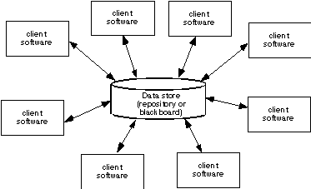
Data-Centered Architecture
These slides are designed to accompany Software Engineering: A Practitioner’s Approach, 8/e (McGraw-Hill, 2014). Slides copyright 2014 by Roger Pressman.

Slide 28
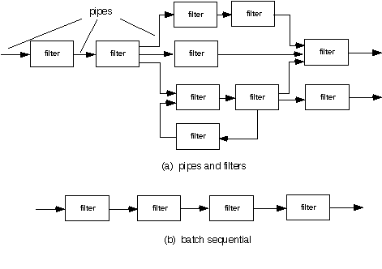
Data Flow Architecture
These slides are designed to accompany Software Engineering: A Practitioner’s Approach, 8/e (McGraw-Hill, 2014). Slides copyright 2014 by Roger Pressman.

Slide 29
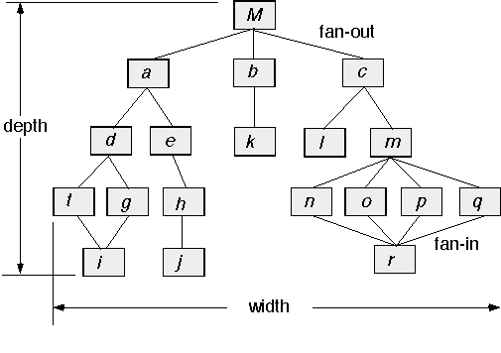
Call and Return Architecture
These slides are designed to accompany Software Engineering: A Practitioner’s Approach, 8/e (McGraw-Hill, 2014). Slides copyright 2014 by Roger Pressman.

Slide 30
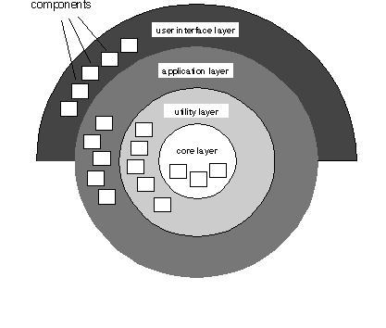
Layered Architecture
These slides are designed to accompany Software Engineering: A Practitioner’s Approach, 8/e (McGraw-Hill, 2014). Slides copyright 2014 by Roger Pressman.

Slide 31
Architectural Patterns
Concurrency—applications must handle multiple tasks in a manner that simulates parallelism
  operating system process management pattern
  task scheduler pattern
Persistence—Data persists if it survives past the execution of the process that created it. Two patterns are common:
  a database management system pattern that applies the storage and retrieval capability of a DBMS to the application architecture
Distribution— the manner in which systems or components within systems communicate with one another in a distributed environment
These slides are designed to accompany Software Engineering: A Practitioner’s Approach, 8/e (McGraw-Hill, 2014). Slides copyright 2014 by Roger Pressman.

Slide 32
Architectural Decision Documentation
Determine which information items are needed for each decision.
Define links between each decision and appropriate requirements.
Provide mechanisms to change status when alternative decisions need to be evaluated.
Define prerequisite relationships among decisions to support traceability.
Link significant decisions to architectural views resulting from decisions.
Document and communicate all decisions as they are made.
These slides are designed to accompany Software Engineering: A Practitioner’s Approach, 8/e (McGraw-Hill, 2014). Slides copyright 2014 by Roger Pressman.

Slide 33
Architecture Reviews
Assess the ability of the software architecture to meet the systems quality requirements and identify potential risks
Have the potential to reduce project costs by detecting design problems early
Often make use of experience-based reviews, prototype evaluation, and scenario reviews, and checklists
These slides are designed to accompany Software Engineering: A Practitioner’s Approach, 8/e (McGraw-Hill, 2014). Slides copyright 2014 by Roger Pressman.

Slide 34
Agility and Architecture
To avoid rework, user stories are used to create and evolve an architectural model (walking skeleton) before coding
Hybrid models which allow software architects contributing users stories to the evolving storyboard
Well run agile projects include delivery of work products during each sprint
Reviewing code emerging from the sprint can be a useful form of architectural review
These slides are designed to accompany Software Engineering: A Practitioner’s Approach, 8/e (McGraw-Hill, 2014). Slides copyright 2014 by Roger Pressman.

